Slide 1
VISUALHYPERTUNER: VISUAL ANALYTICS FOR USER-DRIVEN HYPERPARAMTER TUNING OF DEEP NEURAL NETWORKS
Reference:
Park, Heungseok, Jinwoong Kim, Minkyu Kim, Jae-gyoung Kim, Jaegul Choo, Jungwoo Ha and Nako Sung. “VISUALHYPERTUNER: VISUAL ANALYTICS FOR USER-DRIVEN HYPERPARAMTER TUNING OF DEEP NEURAL NETWORKS.” (2019).
Link to the paper:
https://mlsys.org/Conferences/2019/doc/2019/demo_12.pdf
https://arxiv.org/pdf/1810.03527.pdf

Slide 2
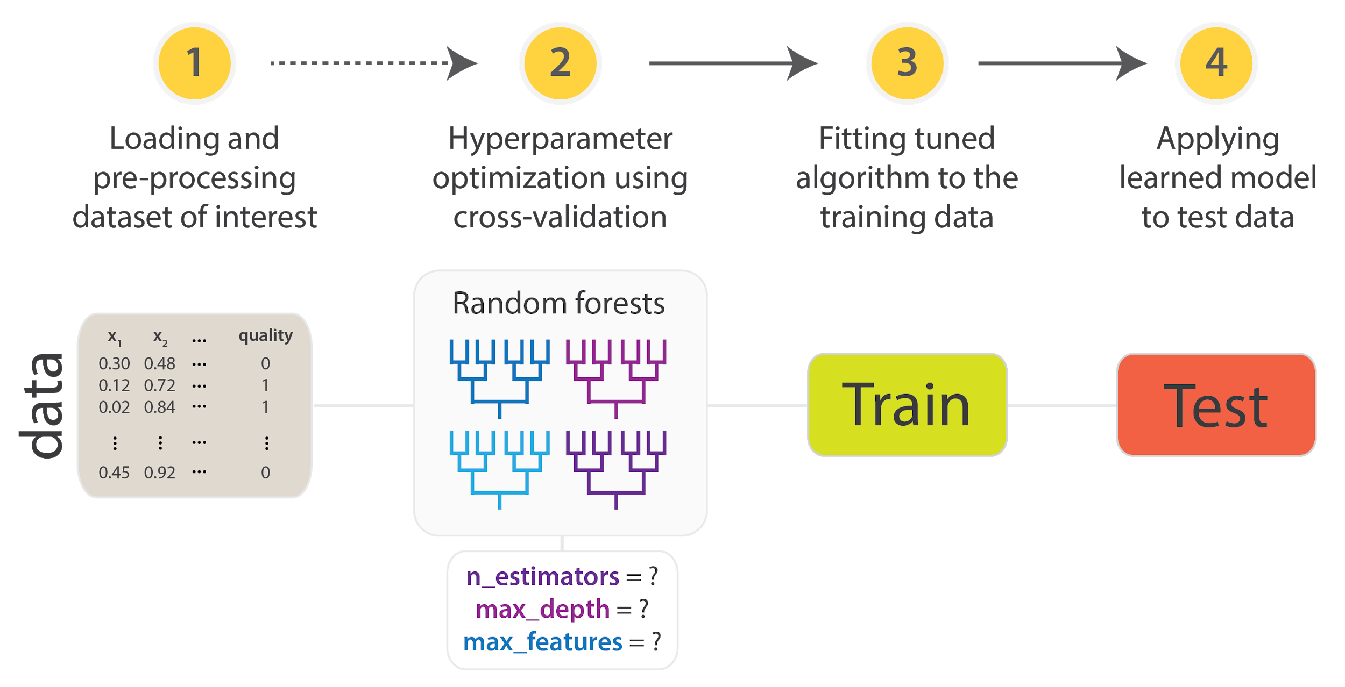
What is the problem?
Deep learning researchers often struggle to find an optimized set of hyperparameters.

Slide 3
Recent studies
Two types of studies have been emerged for parameter optimization.
Algorithm Based and
Platform based - an integration oriented design approach emphasizing systematic reuse
But these methods don’t provide optimal results.

Slide 4
Method Proposed
A method called visual HyperTuner - A web based analytic system.
Works through an interactive and an iterative procedure.

Slide 5
Design goal and requirements
Efficient resource management
Minimum configuration and code modification
A models without implementation overheads
Web-based analytic visual tool
A visualization tool to analyze from hundreds of training results

Slide 6
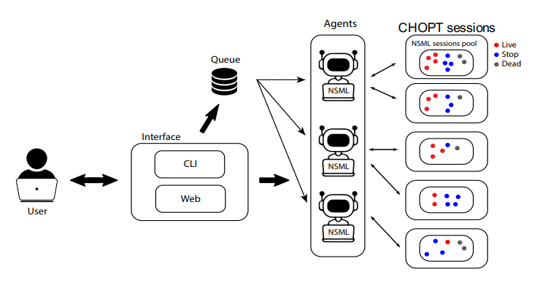
System Architecture
User can run through CLI or Web interface.
The user needs to submit codes and config files.
After session initialization it gets inserted in the queue.
Finally, the session obtained is ran by the agent.

Slide 7
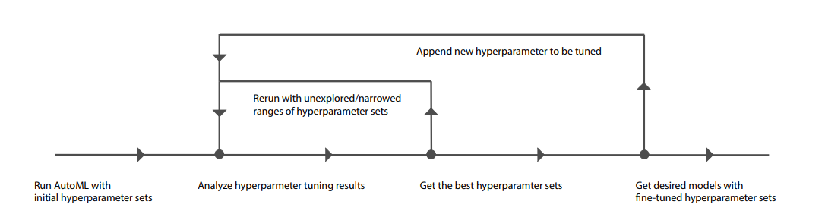
Fine Tuning Workflow

Slide 8
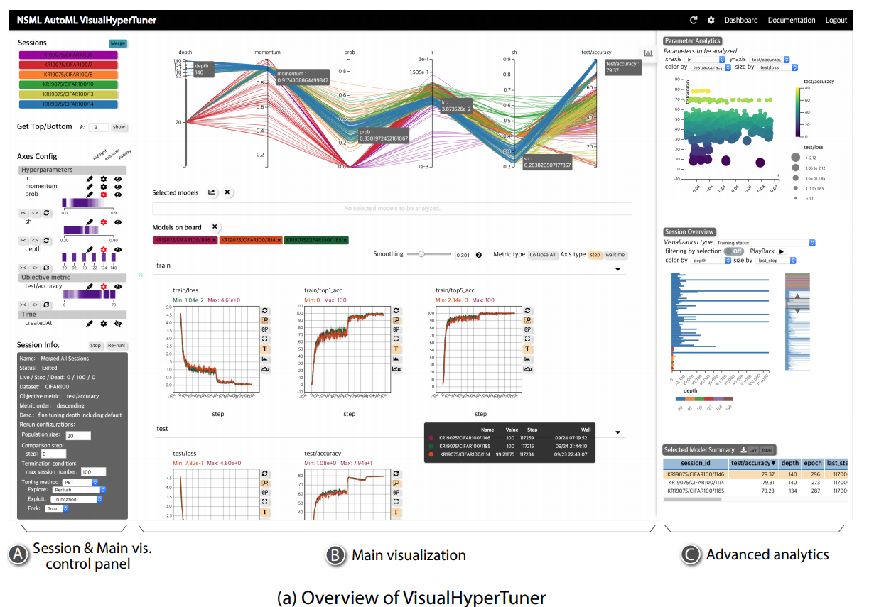
The Model

Slide 9
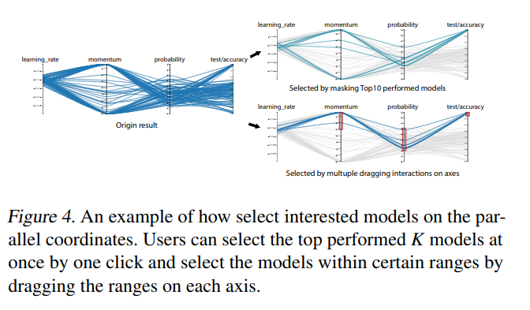
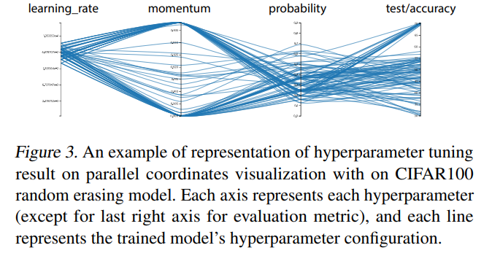
Scalable Hyperparameter Visualization

Slide 10
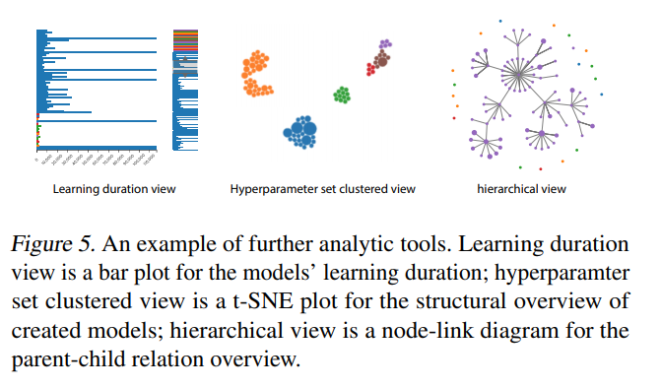
Visualization Feature List
Model Selection and View
Multiple range selection
Highlighting axis
Axis Control
Filtering axis
Controlling range scale
Exhaustive Analysis
Scalar plot view
Model summary view

Slide 11
Usage Scenarios
To demonstration of the working, they use this system for image classification.
The system is applied on Training RESNET.
Dataset used is CIFAR - 100.

Slide 12
Test Cases
Six different hyper parameter settings of ResNet models were applied.
First the initial Hyper-optimization session is executed to fix the learning rate
Then, the user selects the 10 best performing model and obtain a sense of optimal Learning Rate (S3)

Slide 13
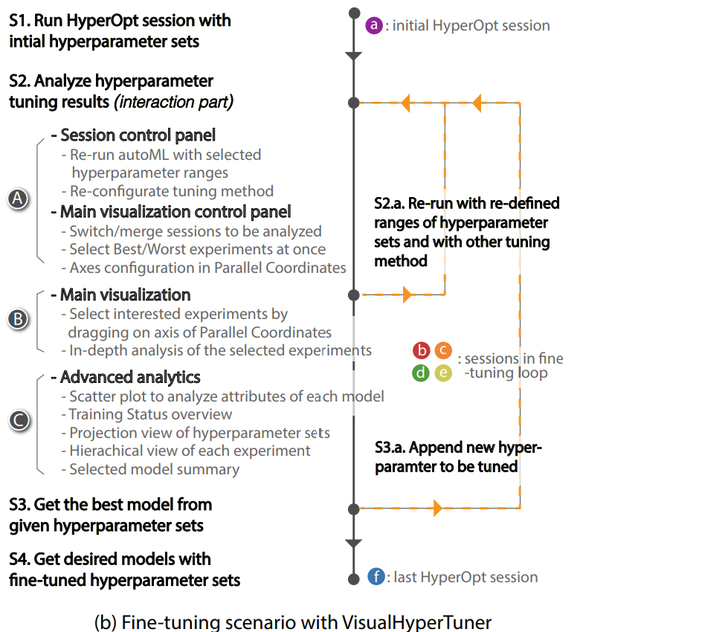
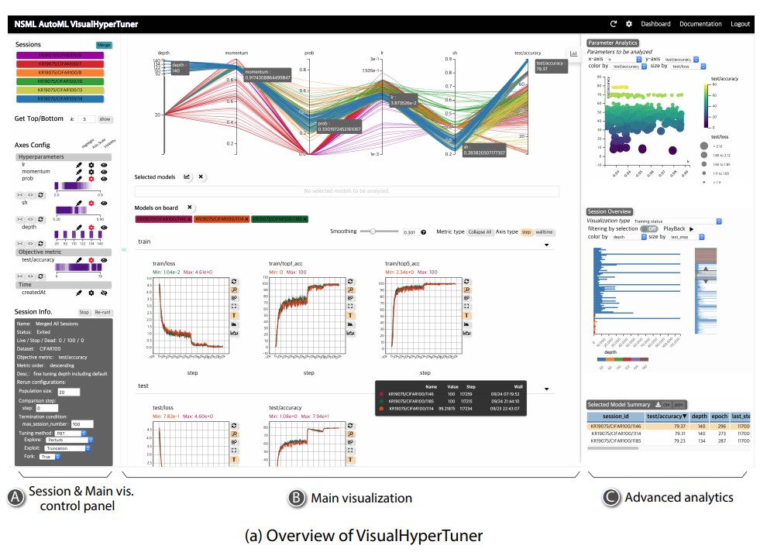
Fine tuning scenarios

Slide 14
Momentum tuning
The user runs the session to tune the momentum (red color).
The session explored the optimum range of learning rate and momentum parameter (S2 and S3).

Slide 15
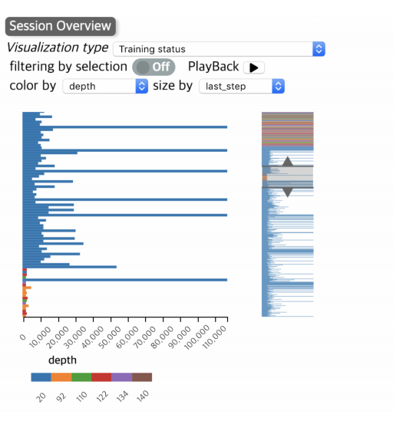
Layer optimization
Finally, the user adds number of layers (Yellow color).
The horizontal bar graph presents that the session only keeps experiments with shallow depth.

Slide 16
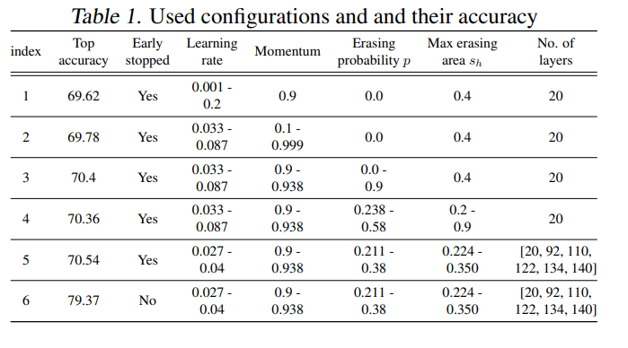
Results
Eventually, the user obtains the performance of 79.37% accuracy.

Slide 17
Conclusion
Visual analytics system called VisualHyperTuner,
A model-agnostic visual analytics system
A user-driven hyperparameter optimization for deep neural networks

Slide 18
Thanks !

